Slide 1
Module 2 - Output Primitives Topic: Aliasing and Anti-Aliasing
By Poonam Pangarkar
Department of CSE Data Science APSIT

Slide 2
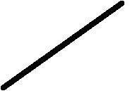
Jagged Line

Slide 3
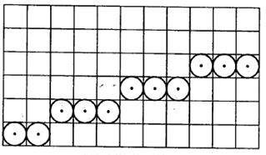
What is aliasing
In computer graphics, the process by which smooth curves and other lines become jagged because the resolution of the graphics device or file is not high enough to represent a smooth curve.
In the line drawing algorithms, we have seen that all rasterized locations do not match with the true line and we have to select the optimum raster locations to represent a straight line. This problem is severe in low resolution screens. In such screens line appears like a stair-step, as shown in the figure below. This effect is known as aliasing. It is dominant for lines having gentle and sharp slopes.

Slide 4
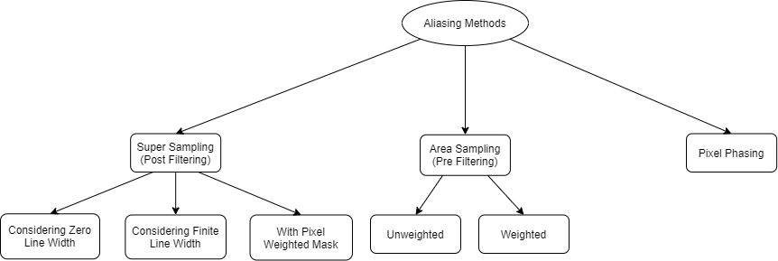
Anti - Aliasing
Anti Aliasing Methods

Slide 5
Super - Sampling
•Post Filtering first super samples the signal in its unfiltered form and then filters out the high frequency from the supersamples.
•Increase the sampling rate by treating the screen as if it had a finer grid resolution than is actually available

Slide 6
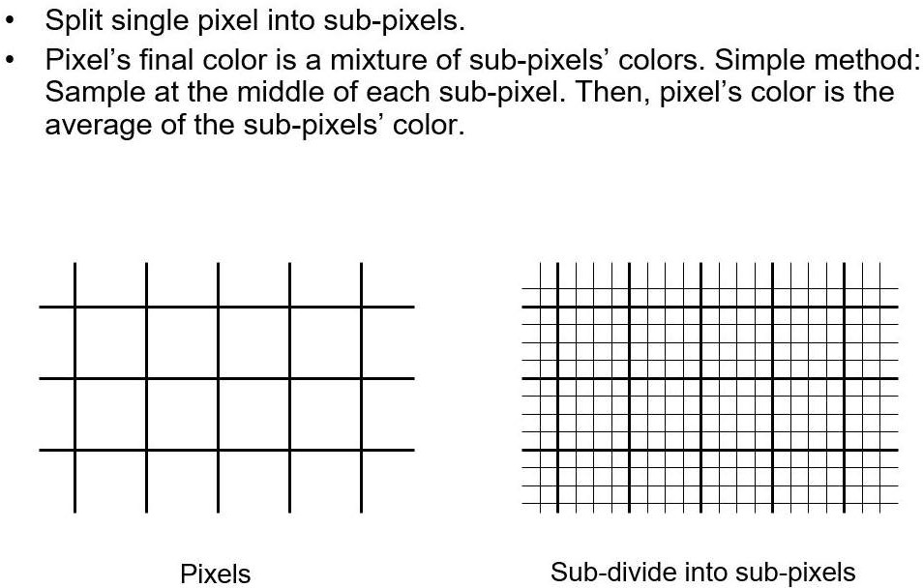
Super - Sampling

Slide 7
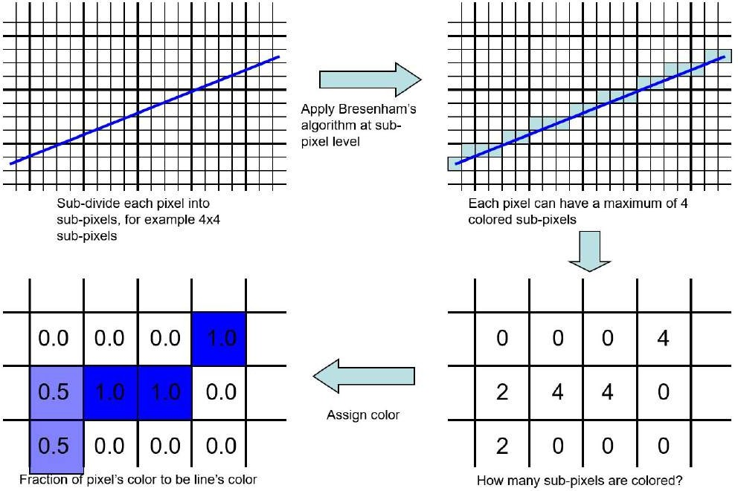
Super-Sampling a Zero-Width Line

Slide 8
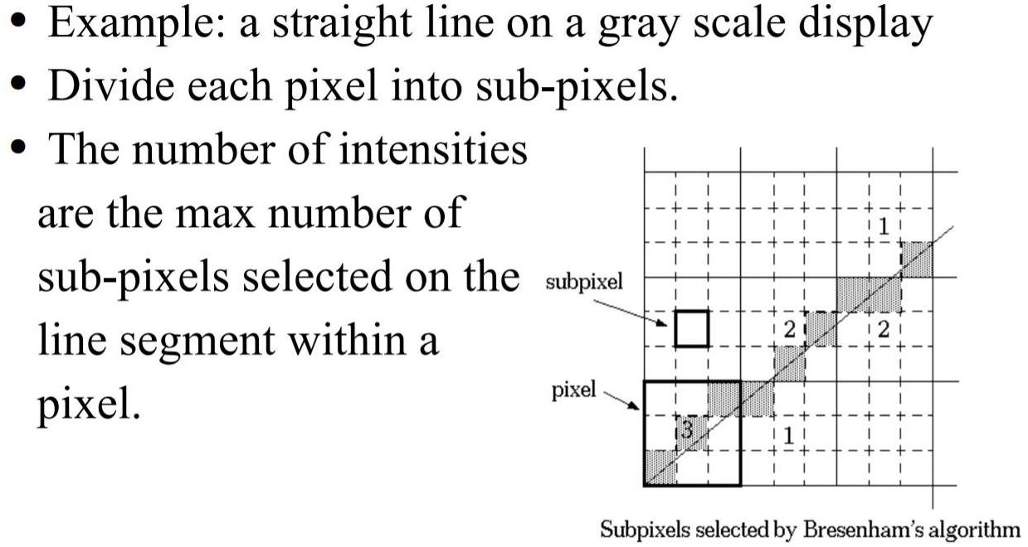
Super-Sampling a Zero-Width Line

Slide 9
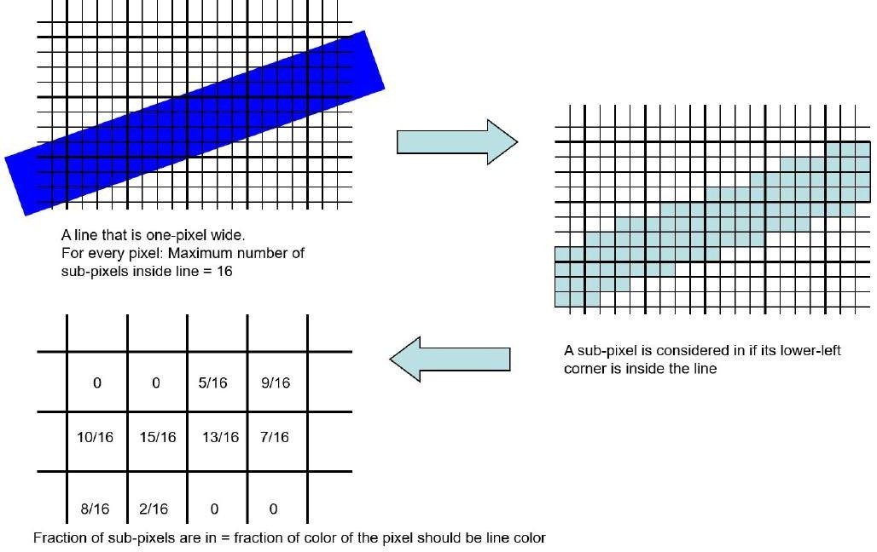
Super-Sampling a Line with Non-Zero Width

Slide 10
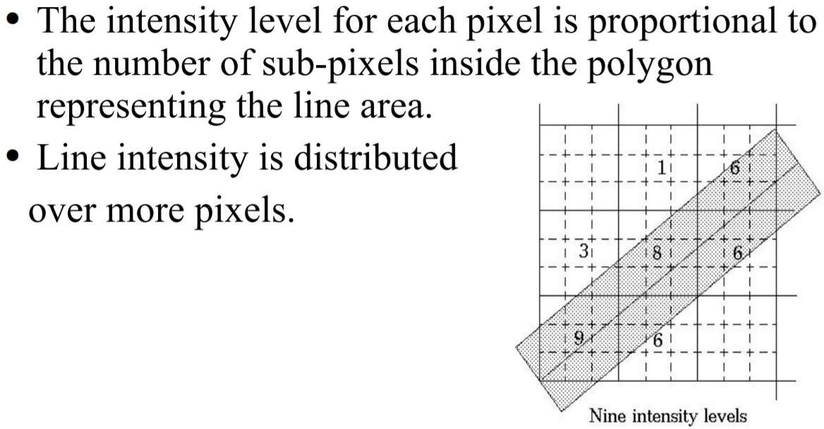
Super-Sampling a Line with Finite Width

Slide 11
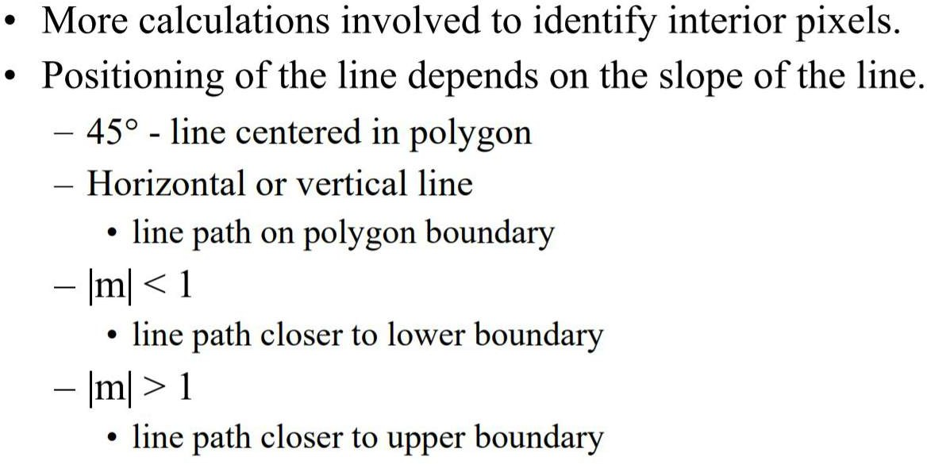
Disadvantages with Finite Width

Slide 12
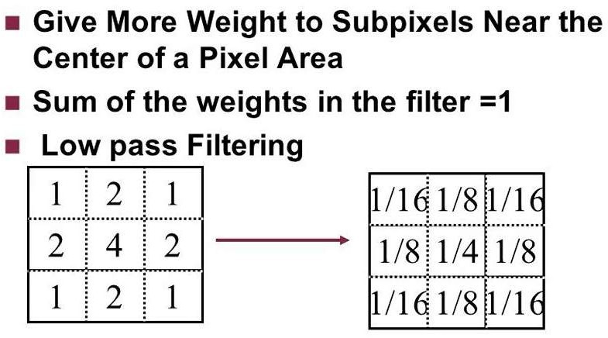
Pixel Weighted Mask

Slide 13
Area Sampling
Central idea is to consider the pixel as an area, not a point, and calculate the pixel colour value from a weighted sum of the colours present inside the area.
e.g. In line-drawing, think of the line as a long rectangle, not the minimal line of pixels found by Bresenham’s method. Pixels partly covered by this rectangle would be shaded grey

Slide 14
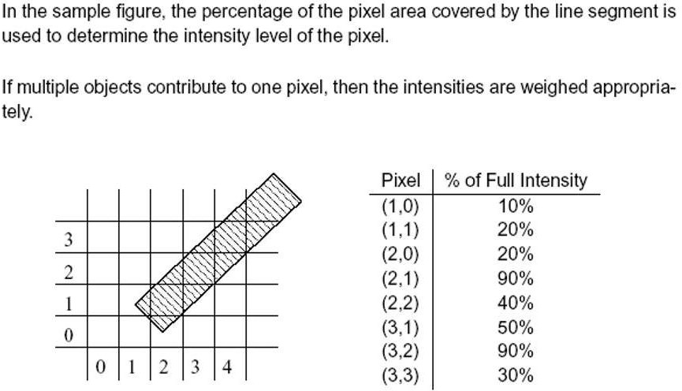
Area Sampling

